Slide 1
Crop Production And Yield Analysis
An Exploratory Data Analysis of Agriculture Production Across India
Tools Used : Excel | SQL | Python | Power BI
Prepared by : Prajvitha Rodrigues
Course : Data Analytics
Institute: ParvaM Software Solution

Slide 2
Project Introduction
Agriculture plays an important role in India's economy and food security.
Crop production varies across states, districts, crops, and agricultural seasons.
Analyzing agricultural data helps us understand production patterns and changes over time.
This project uses data analytics tools to explore crop production across India.
The analysis uses a dataset containing 246,091 records and 7 columns.

Slide 3
Problem Statement & Objectives
Problem Statement
Crop production varies across states, districts, crops, and seasons.
Understanding these variations using raw data can be difficult.
Data analysis helps identify production patterns and changes over time.
Project Objectives
Analyze crop production across Indian states and districts.
Identify crops with high production.
Compare production across agricultural seasons.
Examine yearly production trends.
Visualize important findings using Power BI.

Slide 4
Dataset Description
Data Source: Kaggle
Dataset Overview
Total Records: 246,091
Total Columns: 7
Geographic Coverage: Indian states and districts
Data Type: Agricultural crop production data
Dataset Attributes
State_Name — Name of the state
District_Name — Name of the district
Crop_Year — Year of crop production
Season — Agricultural season
Crop — Name of the crop
Area — Area cultivated
Production — Quantity of crop produced

Slide 5
Tools And Technologies Used
1. Microsoft Excel
Used for initial data inspection and cleaning checks.
Checked missing values, data types, and duplicate records.
2. MySQL
Used to store agricultural data in a database.
Used SQL queries to analyze crop production.
3. Python
Used Pandas and NumPy for data analysis.
Used Matplotlib to create eight visualizations.
4. Power BI
Used to create an interactive dashboard.
Visualized production by state, crop, season, district, and year.

Slide 6
Data Cleaning And Preparation
Data Cleaning Steps
Inspected the dataset using Microsoft Excel.
Checked the seven columns and their data types.
Identified missing values in the Production column.
Checked for duplicate records.
Reviewed crop names, seasons, states, and districts for consistency.
Saved a working copy of the dataset for analysis.
Data Quality Considerations
Missing Production values were kept blank because verified values were unavailable.
Additional validation is required to confirm the accuracy of imported SQL data.

Slide 7
SQL Analysis
SQL Techniques Used
SELECT — Retrieved data from the database.
GROUP BY — Grouped records by state, crop, and season.
SUM() — Calculated total crop production and cultivated area.
ORDER BY — Sorted results to identify the highest production.
LIMIT — Displayed the top 10 states, crops, and districts.
COUNT(DISTINCT) — Counted different crop types across states.
Key Analysis Performed
Top 10 states by production.
Top 10 crops by production.
Production by agricultural season.
Yearly production trends.
Top 10 districts by production.
Crop counts by state.

Slide 8
Python Exploratory Data Analysis
Python Libraries Used
Pandas: Loaded and analyzed the agricultural dataset.
NumPy: Supported numerical analysis.
Matplotlib: Created charts to visualize production patterns.
Analysis Performed
Examined dataset dimensions and column names.
Checked missing values and duplicate records.
Analyzed crop production across states and crops.
Compared production across agricultural seasons.
Examined yearly production trends.
Identified leading districts by production.
Created eight visualizations to understand agricultural data.
Output Eight charts and a Python EDA summary file were generated.

Slide 9
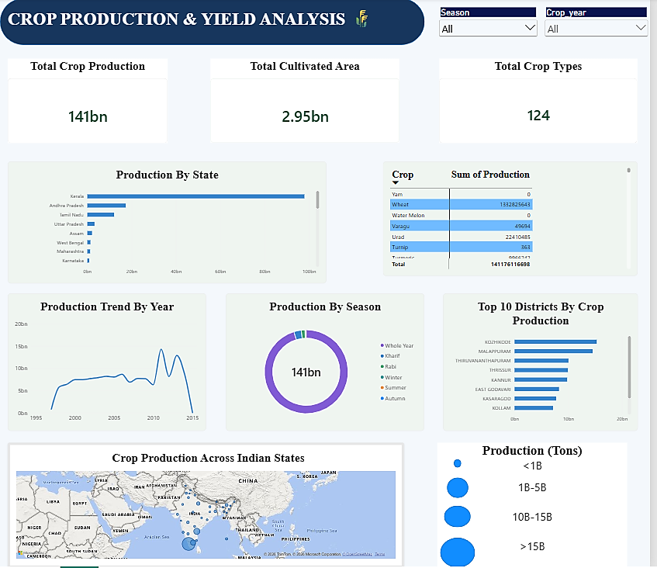
Power BI Dashboard

Slide 10
THANK YOU

